Slide 1
Module 3:
Working with Design
Patterns and Anti-patterns
1

Slide 2

Module 3: Working with Design Patterns and Anti-patterns
Module Focus
  Understand how design patterns are applied in real software designs.
  Understand MVC as a design pattern for separating user-interface responsibilities.
  Apply general design principles to evaluate software structure.
  Analyze and critique code that exhibits poor design.
  Recognize anti-patterns and code smells before they make a system difficult to maintain.
  Use refactoring to improve internal code structure without changing external behavior.
Key idea: Good design is not only about selecting a pattern; it is also about recognizing when a design has become unnecessarily coupled, complex, duplicated, or difficult to maintain.
1

Slide 3
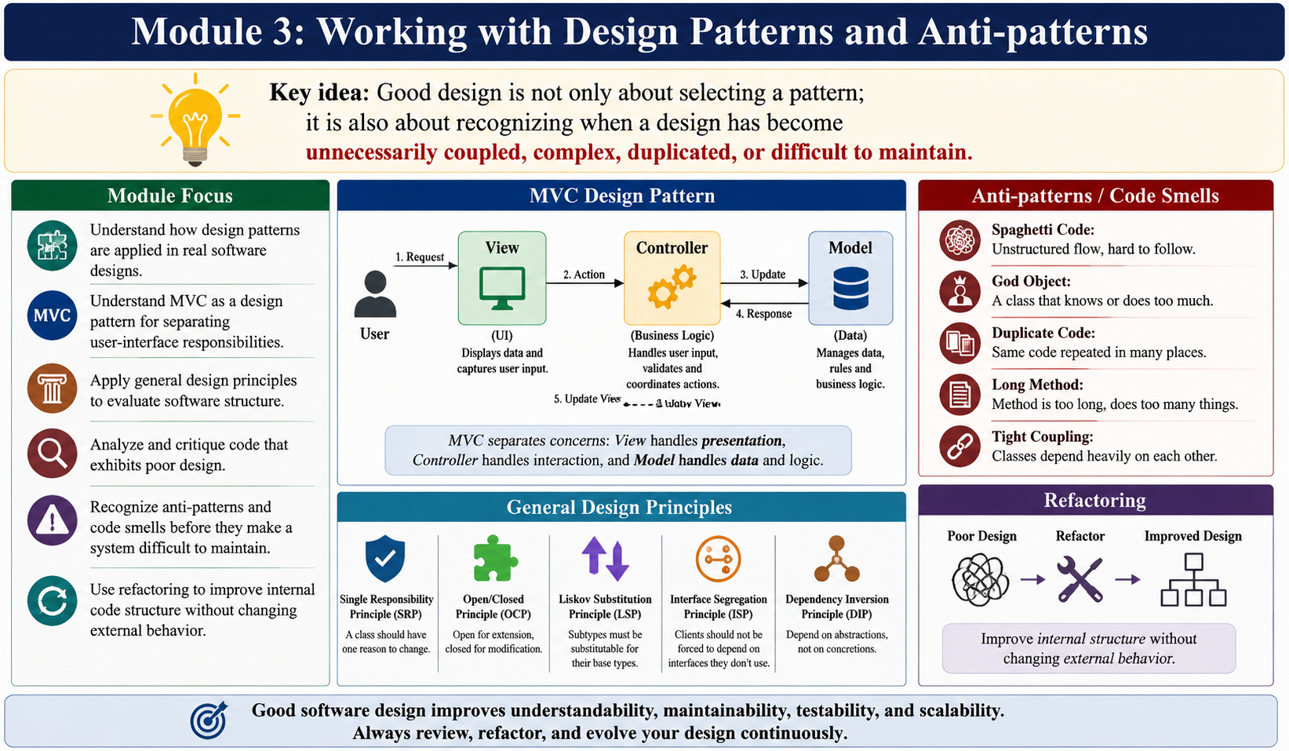
Module 3: Working with Design Patterns and Anti-patterns
Module Focus
  Understand how design patterns are applied in real software designs.
  Understand MVC as a design pattern for separating user-interface responsibilities.
  Apply general design principles to evaluate software structure.
  Analyze and critique code that exhibits poor design.
  Recognize anti-patterns and code smells before they make a system difficult to maintain.
  Use refactoring to improve internal code structure without changing external behavior.
Key idea: Good design is not only about selecting a pattern; it is also about recognizing when a design has become unnecessarily coupled, complex, duplicated, or difficult to maintain.
Dfd
1

Slide 4
MVC Design Pattern — Overview
The Model–View–Controller (MVC) pattern divides the responsibilities of a system that offers a user interface into three parts: Model, View, and Controller.
Model: Contains the underlying data and logic that users want to see and manipulate through an interface.
View: Allows users to see all or part of the model.
Controller: Interprets user requests and changes the model.
Main Goal: Separate responsibilities so that user-interface presentation, request handling, and application data/logic are not unnecessarily mixed together.
Controller
interprets request
Model
data + logic
View
presents model
User
2

Slide 5
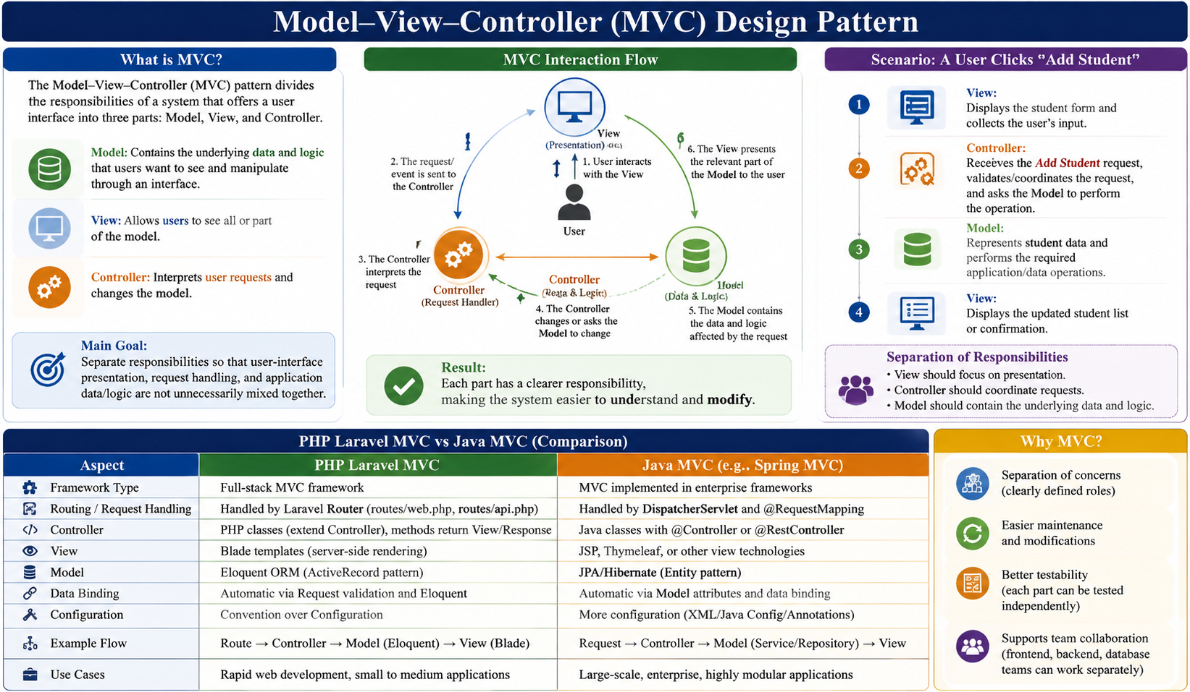

Slide 6
MVC — Request and Response Flow
Typical interaction flow:
1. User interacts with the View.
2. The request/event is sent to the Controller.
3. The Controller interprets the request.
4. The Controller changes or asks the Model to change.
5. The Model contains the data and logic affected by the request.
6. The View presents the relevant part of the Model to the user.
Result: Each part has a clearer responsibility, making the system easier to understand and modify.
User
View
Controller
Model
Updated View
3

Slide 7
MVC — Simple Example: Student Management System
Scenario: A user clicks “Add Student”.
View: Displays the student form and collects the user's input.
Controller: Receives the Add Student request, validates/coordinates the request, and asks the Model to perform the operation.
Model: Represents student data and performs the required application/data operations.
View: Displays the updated student list or confirmation.
Separation of responsibilities:
  View should focus on presentation.
  Controller should coordinate requests.
  Model should contain the underlying data and logic.
4

Slide 8
General Design Principles — Why They Matter
Design principles provide guidance for creating reusable, flexible, understandable, and maintainable software.
Information Hiding: Modules should expose the minimum information needed to use them correctly and hide the rest.
Separation of Concerns: Organize software so different concerns are separated into different sections and addressed effectively.
Dependency Inversion: High-level modules should depend on high-level generalizations rather than low-level implementation details.
Open/Closed Principle: Classes should be open for extension but closed to change.
Interface Segregation: A class should not be forced to depend on methods it does not use.
Coupling Objects Principle: Classes should achieve code reuse through aggregation rather than inheritance.
5

Slide 9
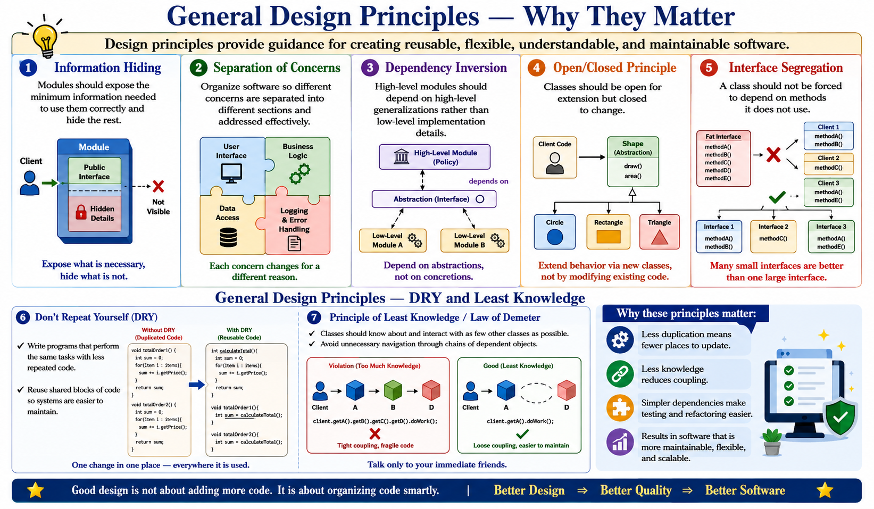
General Design Principles — Why They Matter
5

Slide 10
General Design Principles — DRY and Least Knowledge
Don't Repeat Yourself (DRY)
  Write programs that perform the same tasks with less repeated code.
  Reuse shared blocks of code so systems are easier to maintain.
Principle of Least Knowledge / Law of Demeter
  Classes should know about and interact with as few other classes as possible.
  Avoid unnecessary navigation through chains of dependent objects.
  Why these principles matter:
    Less duplication means fewer places to update.
    Less knowledge reduces coupling.
    Simpler dependencies make testing and refactoring easier.
6

Slide 11
How to Analyze and Critique a Design — Checklist
Step 1: Identify Responsibilities
Ask: What does each class actually do? Does it have one clear purpose?
Step 2: Identify Dependencies
Ask: Which classes know about each other? Are there unnecessary dependencies or cycles?
Step 3: Check Coupling and Cohesion
Ask: Are responsibilities tightly connected inside a class, and are unrelated responsibilities separated?
Step 4: Look for Code Smells: Check for duplication, long methods, large classes, message chains, primitive obsession, switch statements, and inappropriate intimacy.
Step 5: Check Principles: Review information hiding, separation of concerns, DRY, least knowledge, dependency inversion, open/closed, and interface segregation.
Step 6: Refactor: Improve the internal structure while preserving external behavior.
18

Slide 12
Analyzing and Critiquing Code — What Is Bad Design?
When reviewing code, ask:
1. Does one class have too many unrelated responsibilities?
2. Are responsibilities placed in the wrong class?
3. Are classes tightly coupled through unnecessary dependencies?
4. Is the same logic duplicated in multiple locations?
5. Are long methods, long parameter lists, or long call chains making behavior difficult to understand?
6. Are primitive values being used where meaningful abstractions/classes should exist?
7. Are switch statements scattered throughout the system?
8. Is the code generalized for requirements that do not yet exist?
9. Does inheritance force subclasses to receive behavior they do not need?
7

Slide 13
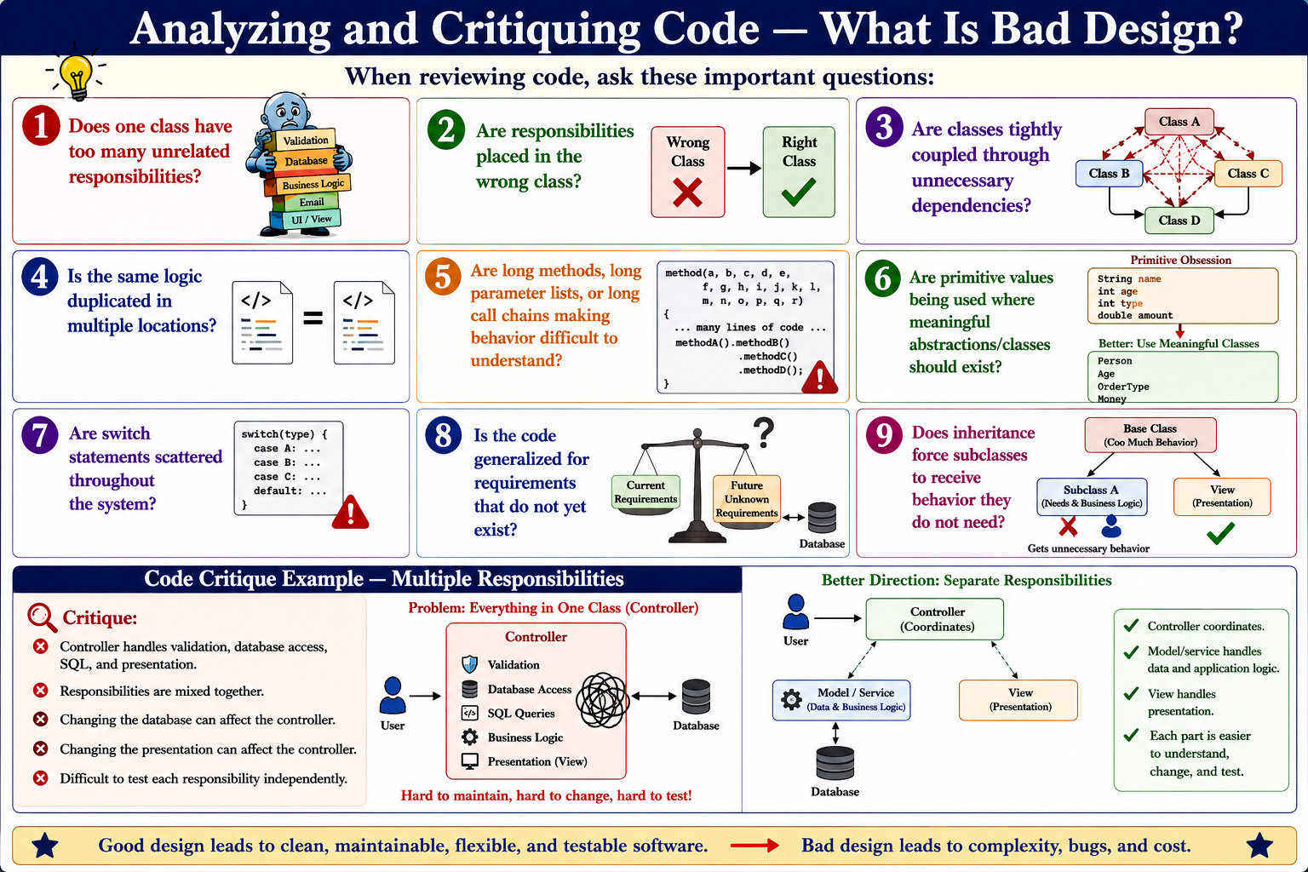
7

Slide 14
Code Analysis/ Code Critique Example — Multiple Responsibilities
class StudentController {
void addStudent(String name, String email) {
// validate input
if (name == null || name.isEmpty()) return;
// create database connection
Connection db = DriverManager.getConnection(...);
// SQL operation
String sql =
"INSERT INTO students(name,email) VALUES(?,?)";
// execute SQL
// ...
// format HTML response
System.out.println(
"<html><body>Student Added</body></html>");
}
}
Critique:
  Controller handles validation, database access, SQL, and presentation.
  Responsibilities are mixed together.
  Changing the database can affect the controller.
  Changing the presentation can affect the controller.
  Difficult to test each responsibility independently.
Better direction:
  Controller coordinates.
  Model/service handles data and application logic.
  View handles presentation.
8

Slide 15
Code Analysis/ Code Critique Example — Scattered Switch Statements
double calculatePrice(String type) {
switch(type) {
case "REGULAR": return 100;
case "PREMIUM": return 150;
default: return 0;
}
}
String getDescription(String type) {
switch(type) {
case "REGULAR": return "Regular";
case "PREMIUM": return "Premium";
default: return "Unknown";
}
}
double getDiscount(String type) {
switch(type) {
case "REGULAR": return 0.05;
case "PREMIUM": return 0.15;
default: return 0;
}
}
Critique:
  The same type information is checked repeatedly.
  Adding a new type requires changing several methods.
  The design can become difficult to maintain.
  This is the kind of situation where polymorphism may reduce scattered conditionals.
Possible refactoring:
  Create a common Product/Customer/Plan abstraction.
  Move price, description, and discount behavior into the appropriate concrete classes.
15

Slide 16
Code Analysis/ Code Critique Example — Primitive Obsession
Potential smell:
  Many Strings represent different concepts.
  The code does not clearly express the domain abstractions.
  Validation and behavior may be duplicated across the system.
Possible improvement:
  Create meaningful types such as Customer, EmailAddress, Address, PostalCode, and Money where appropriate.
  Encapsulate validation and related behavior in those abstractions.
Result: The design communicates the domain more clearly and reduces primitive obsession.
void createOrder(
String customerName,
String customerEmail,
String country,
String currency,
String street,
String city,
String postalCode) {
// many operations using raw Strings
}
16

Slide 17
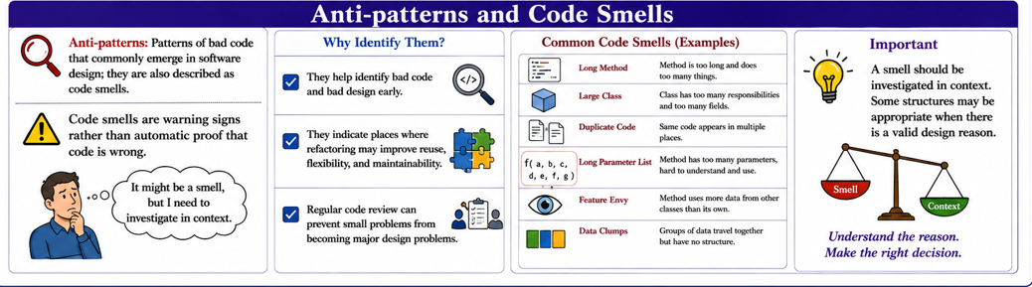
9

Slide 18
Anti-patterns and Code Smells
Anti-patterns: Patterns of bad code that commonly emerge in software design; they are also described as code smells.
Code smells are warning signs rather than automatic proof that code is wrong.
Why Identify Them?
  They help identify bad code and bad design early.
  They indicate places where refactoring may improve reuse, flexibility, and maintainability.
  Regular code review can prevent small problems from becoming major design problems.
Important: A smell should be investigated in context. Some structures may be appropriate when there is a valid design reason.
10

Slide 19
Common Anti-patterns / Code Smells in This Module
Large Class — a class that is too long; also called a God, Blob, or Black Hole class.
Long Method — a method containing excessive logic.
Duplicated Code — similar code blocks appear in multiple places with slight differences.
Data Class — a class containing mostly data and little real functionality.
Data Clumps — groups of data repeatedly appear together as fields or method parameters.
Divergent Change — one class must be changed in many different ways for many different reasons.
Shotgun Surgery — one requirement change requires changes across many classes.
Feature Envy — a method is more interested in another class's details than its own class.
Long Parameter Lists — methods require too many parameters.
Comments as a smell — excessive comments may indicate that comments are being used to explain or cover a difficult design.
11

Slide 20
Code Smells — Inappropriate Intimacy and Message Chains
Inappropriate Intimacy: Occurs when two classes depend too much on each other through two-way communication.
  If methods in one class call the other and vice versa, consider removing the cycle.
  Factor methods so both classes can use another class, or at least make communication one-way.
Message Chains: Long chains of calls can create rigidity and complexity and make code harder to test independently.
  They can violate the Law of Demeter when objects know too much about other objects' dependencies.
  Navigation through dependencies should not be unnecessarily baked into objects.
Important qualification: A message chain is not automatically bad if it returns a limited set of objects and follows the Law of Demeter.
12

Slide 21
Code Smells — Primitive Obsession and Switch Statements
Primitive Obsession:
  Occurs when the design relies too much on built-in types such as int, long, float, and String.
  Overuse can indicate that meaningful abstractions/classes have not been identified.
  High-level use of primitives may hide important domain concepts.
Switch Statements:
  Scattered switch statements become a problem because changing one case may require finding and updating many other switches.
  When conditionals repeatedly check type codes, consider whether polymorphism could express the behavior more clearly.
Better direction: Identify missing abstractions and move behavior into appropriate classes rather than encoding everything as primitive values or repeated conditionals.
13

Slide 22
Code Smells — Speculative Generality and Refused Request
Speculative Generality
  Creating a superclass, interface, or code that is not currently needed but may be useful someday.
  It introduces generality that may not help and can over-engineer the system.
  Just-in-Time Design suggests designing only what is needed for the current requirements/iteration.
  If generalization becomes necessary later, refactor when the requirement is real.
Refused Request
  A subclass inherits behavior that it does not need or use.
  This may indicate that the subclass is not appropriate for the superclass.
  Consider a standalone class or move behavior to the subclasses that actually need it.
14

Slide 23
Example-1: Code Smells — Problem
Problem: A method contains 100 lines of code and performs validation, database access, calculations, and report generation. Identify the likely code smell and suggest an appropriate refactoring approach
Solution: Likely Code Smell: Long Method
The method contains 100 lines of code and performs several different responsibilities:
  Input validation
  Database access
  Calculations
  Report generation
This indicates that the method has too many responsibilities, making it difficult to understand, test, maintain, and modify.
Appropriate Refactoring Approach: Extract Method
The large method should be divided into several smaller, focused methods, where each method performs one specific task.
The likely code smell is Long Method because the method contains about 100 lines and performs several different responsibilities such as validation, database access, calculation, and report generation. The appropriate refactoring technique is Extract Method. The large method should be divided into smaller methods such as validateStudent(), getStudentMarks(), calculateAverage(), and generateReport(). This improves readability, maintainability, reusability, and testability.
14

Slide 24
Code Smells — Problem
private double calculateAverage(List<Double> marks) {
if (marks.isEmpty()) {
return 0;
}
double total = 0;
for (double mark : marks) {
total += mark;
}
return total / marks.size();
}
Before Refactoring Long Method:
public void processStudent() {
// Validation
if (studentName == null || studentName.isEmpty()) {
System.out.println("Invalid student name");
return;
}
if (studentId <= 0) {
System.out.println("Invalid student ID");
return;
}
// Database access
Connection con = DriverManager.getConnection(
"jdbc:mysql://localhost:3306/university",
"root",
"password"
);
PreparedStatement ps = con.prepareStatement(
"SELECT marks FROM students WHERE id = ?"
);
ps.setInt(1, studentId);
ResultSet rs = ps.executeQuery();
// Calculation
double total = 0;
int count = 0;
while (rs.next()) {
total += rs.getDouble("marks");
count++;
}
double average = total / count;
// Report generation
System.out.println("Student: " + studentName);
System.out.println("Student ID: " + studentId);
System.out.println("Average Marks: " + average);
// Many more lines...
}
After Refactoring:
public void processStudent() {
if (!validateStudent()) {
return;
}
List<Double> marks = getStudentMarks();
double average = calculateAverage(marks);
generateReport(average);
}
The responsibilities are now separated:
private boolean validateStudent() {
if (studentName == null || studentName.isEmpty()) {
System.out.println("Invalid student name");
return false;
}
if (studentId <= 0) {
System.out.println("Invalid student ID");
return false;
}
return true;
}
private List<Double> getStudentMarks() {
List<Double> marks = new ArrayList<>();
// Database access code
// Execute SQL query
// Retrieve marks
return marks;
}
private void generateReport(double average) {
System.out.println("Student: " + studentName);
System.out.println("Student ID: " + studentId);
System.out.println("Average Marks: " + average);
}
Item | Answer
Code Smell | Long Method
Problem | One method performs too many tasks
Refactoring Technique | Extract Method
Main benefit | Improves readability, maintainability, and testability
Extracted methods | validateStudent(), getStudentMarks(), calculateAverage(), generateReport()
14

Slide 25
Code Smells — Speculative Generality and Refused Request
Speculative Generality
  Creating a superclass, interface, or code that is not currently needed but may be useful someday.
  It introduces generality that may not help and can over-engineer the system.
  Just-in-Time Design suggests designing only what is needed for the current requirements/iteration.
  If generalization becomes necessary later, refactor when the requirement is real.
Refused Request
  A subclass inherits behavior that it does not need or use.
  This may indicate that the subclass is not appropriate for the superclass.
  Consider a standalone class or move behavior to the subclasses that actually need it.
14

Slide 26
MVC Anti-pattern — When Responsibilities Are Mixed
A common poor MVC design occurs when one class attempts to perform the responsibilities of Model, View, and Controller simultaneously.
Symptoms:
  Database queries inside UI code.
  HTML/UI formatting inside data/model classes.
  Business rules directly inside event-handling code.
  Controllers that become extremely large and perform every operation themselves.
Problems:
  High coupling.
  Difficult testing.
  Difficult maintenance.
  Changes in one concern affect unrelated concerns.
Better approach: Preserve separation of concerns and assign each responsibility to the appropriate MVC component.
17

Slide 27
Example-2: If a System Suffering from a Large Class and Duplicated Code
1. Identify the Code Smells
  There are two major code smells:
  Large Class – One class contains too many responsibilities.
  Duplicated Code – The same or very similar code is repeated in multiple methods.
Example Scenario
Suppose we have a StudentManager class that handles:
  Student information
  Student validation
  Database operations
  Fee calculation
  Report generation
  Email notification
This violates the Single Responsibility Principle (SRP).
17
Notes:
The system suffers from Large Class because one class performs several unrelated responsibilities such as validation, database access, fee calculation, report generation, and email notification. It also suffers from Duplicated Code because validation and fee-calculation logic are repeated.
The appropriate refactoring is to Extract Class and centralize duplicated logic. The responsibilities can be redistributed into StudentValidator, StudentRepository, FeeCalculator, ReportGenerator, and EmailService, while StudentService coordinates these classes. This improves cohesion, maintainability, reusability, testability, and adherence to the Single Responsibility Principle. Expected key answer:
Large Class → Extract Class / Redistribute Responsibilities
Duplicated Code → Extract Method / Centralize Common Logic

Slide 28
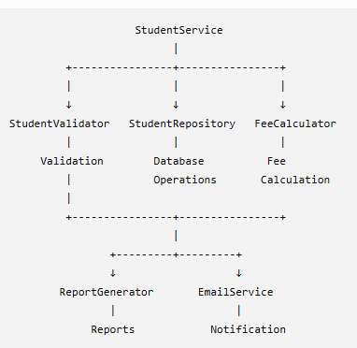
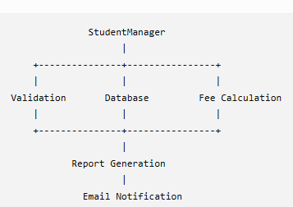
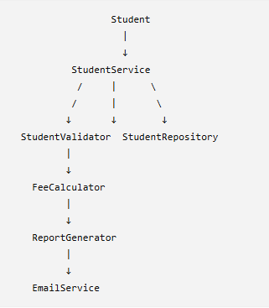
6. Final Design: The final structure can be represented as:
2. Before Refactoring
A poorly designed class might very long code
For Example: The StudentManager class is doing too many jobs:
It also contains duplicated validation and fee-calculation code.
3. Refactored Design
We can redistribute the responsibilities into several classes:
Class | Responsibility
Student | Store student information
StudentValidator | Validate student information
StudentRepository | Database operations
FeeCalculator | Calculate tuition fees
ReportGenerator | Generate student reports
EmailService | Send email notifications
StudentService | Coordinate the overall student operation
17

Slide 29
If a System Suffering from a Large Class and Duplicated Code: Java Example
Before Refactoring Long Method:
public class StudentManager {
private String name;
private int studentId;
private double tuitionFee;
public void registerStudent() {
// Student validation
if (name == null || name.isEmpty()) {
System.out.println("Invalid student name");
return;
}
if (studentId <= 0) {
System.out.println("Invalid student ID");
return;
}
// Database operation
System.out.println("Saving student to database...");
// Fee calculation
double fee = tuitionFee;
if (fee > 50000) {
fee = fee * 0.90; // 10% discount
}
System.out.println("Final fee: " + fee);
// Report generation
System.out.println("Student Report");
System.out.println("Name: " + name);
System.out.println("ID: " + studentId);
// Email notification
System.out.println("Sending email to student...");
}
public void updateStudent() {
// Same validation code - DUPLICATED
if (name == null || name.isEmpty()) {
System.out.println("Invalid student name");
return;
}
if (studentId <= 0) {
System.out.println("Invalid student ID");
return;
}
// Database operation
System.out.println("Updating student in database...");
// Same fee calculation - DUPLICATED
double fee = tuitionFee;
if (fee > 50000) {
fee = fee * 0.90;
}
System.out.println("Updated fee: " + fee);
// Email notification
System.out.println("Sending email to student...");
}
}

Slide 30
If a System Suffering from a Large Class and Duplicated Code: Java Example
After Refactoring Long Method:
public class FeeCalculator {
public double calculateFee(double tuitionFee) {
if (tuitionFee > 50000) {
return tuitionFee * 0.90;
}
return tuitionFee;
}
}
public class Student {
private int studentId;
private String name;
private double tuitionFee;
public Student(int studentId, String name, double tuitionFee) {
this.studentId = studentId;
this.name = name;
this.tuitionFee = tuitionFee;
}
public int getStudentId() {
return studentId;
}
public String getName() {
return name;
}
public double getTuitionFee() {
return tuitionFee;
}
}
public class StudentValidator {
public boolean isValid(Student student) {
if (student.getName() == null ||
student.getName().isEmpty()) {
return false;
}
if (student.getStudentId() <= 0) {
return false;
}
return true;
}
}
public class EmailService {
public void sendEmail(Student student) {
System.out.println(
"Sending email to " + student.getName()
);
}
}
public class ReportGenerator {
public void generate(Student student, double fee) {
System.out.println("Student Report");
System.out.println("Name: " + student.getName());
System.out.println("ID: " + student.getStudentId());
System.out.println("Final Fee: " + fee);
}
}
public class StudentService {
private StudentValidator validator;
private StudentRepository repository;
private FeeCalculator calculator;
private ReportGenerator reportGenerator;
private EmailService emailService;
public StudentService() {
validator = new StudentValidator();
repository = new StudentRepository();
calculator = new FeeCalculator();
reportGenerator = new ReportGenerator();
emailService = new EmailService();
}
public void registerStudent(Student student) {
if (!validator.isValid(student)) {
System.out.println("Invalid student information.");
return;
}
repository.save(student);
double fee =
calculator.calculateFee(student.getTuitionFee());
reportGenerator.generate(student, fee);
emailService.sendEmail(student);
}
public void updateStudent(Student student) {
if (!validator.isValid(student)) {
System.out.println("Invalid student information.");
return;
}
repository.update(student);
double fee =
calculator.calculateFee(student.getTuitionFee());
reportGenerator.generate(student, fee);
emailService.sendEmail(student);
}
}
public class StudentRepository {
public void save(Student student) {
System.out.println("Saving student to database...");
}
public void update(Student student) {
System.out.println("Updating student in database...");
}
}

Slide 31
If a System Suffering from a Large Class and Duplicated Code: Java Example
After Refactoring Long Method:
public class StudentService {
private StudentValidator validator;
private StudentRepository repository;
private FeeCalculator calculator;
private ReportGenerator reportGenerator;
private EmailService emailService;
public StudentService() {
validator = new StudentValidator();
repository = new StudentRepository();
calculator = new FeeCalculator();
reportGenerator = new ReportGenerator();
emailService = new EmailService();
}
public void registerStudent(Student student) {
if (!validator.isValid(student)) {
System.out.println("Invalid student information.");
return;
}
repository.save(student);
double fee =
calculator.calculateFee(student.getTuitionFee());
reportGenerator.generate(student, fee);
emailService.sendEmail(student);
}
public void updateStudent(Student student) {
if (!validator.isValid(student)) {
System.out.println("Invalid student information.");
return;
}
repository.update(student);
double fee =
calculator.calculateFee(student.getTuitionFee());
reportGenerator.generate(student, fee);
emailService.sendEmail(student);
}
}
Problem | Refactoring Solution
Large Class | Extract Class / Responsibility redistribution
Duplicated Code | Extract Method / Move common logic to a single class
Too many responsibilities | Apply Single Responsibility Principle (SRP)
Repeated validation | Centralize in StudentValidator
Repeated fee calculation | Centralize in FeeCalculator
Database code mixed with business logic | Move to StudentRepository

Slide 32
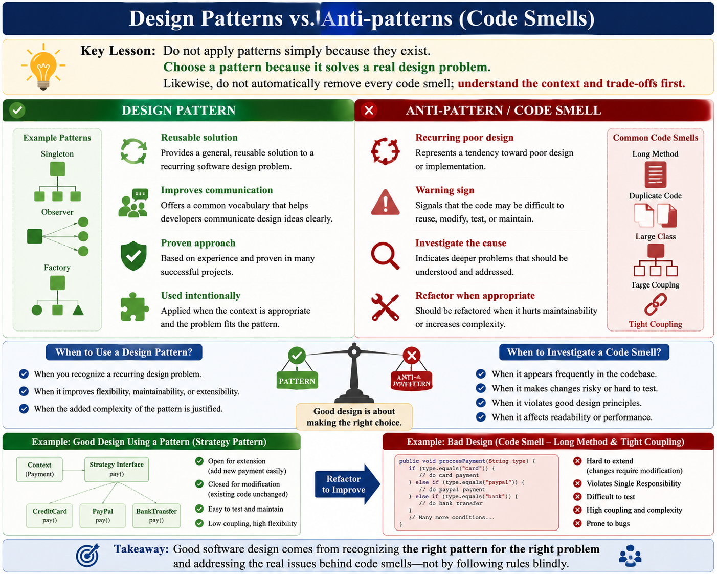
Design Patterns vs. Anti-patterns
19

Slide 33
Design Patterns vs. Anti-patterns
Design Pattern
  Reusable solution to a recurring software design problem.
  Improves communication and provides a proven design approach.
  Used intentionally when the context is appropriate.
Anti-pattern / Code Smell
  Recurring poor design or implementation tendency.
  Warns that code may be difficult to reuse, modify, test, or maintain.
  Should be investigated and potentially refactored.
Key lesson:
  Do not apply patterns simply because they exist.
  Choose a pattern because it solves a real design problem.
  Likewise, do not automatically remove every code smell; understand the context and trade-offs first.
19

Slide 34
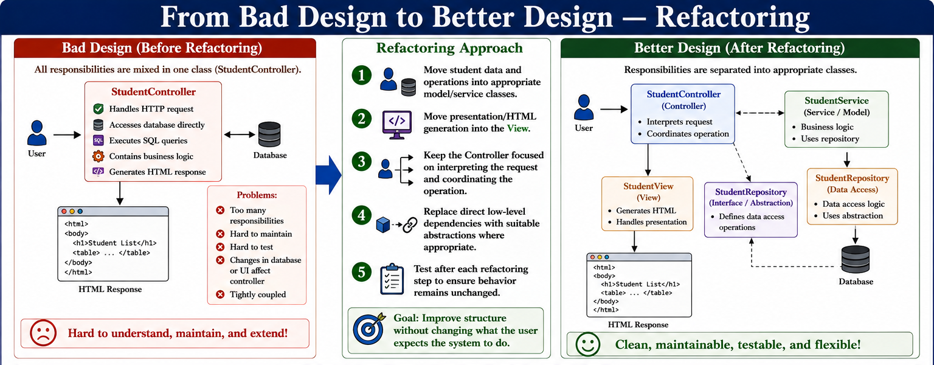
20

Slide 35
From Bad Design to Better Design — Refactoring
Refactoring
Refactoring is the process of changing code so that its external behavior remains the same while its internal structure is improved.
Refactoring approach for the previous example:
1. Move student data and operations into appropriate model/service classes.
2. Move presentation/HTML generation into the View.
3. Keep the Controller focused on interpreting the request and coordinating the operation.
4. Replace direct low-level dependencies with suitable abstractions where appropriate.
5. Test after each refactoring step to ensure behavior remains unchanged.
Goal: Improve structure without changing what the user expects the system to do.
9

Slide 36
Goal
Create software that remains reusable, flexible, understandable, and maintainable as requirements change.
Key idea: Good design is not only about selecting a pattern; it is also about recognizing when a design has become unnecessarily coupled, complex, duplicated, or difficult to maintain.
9

Slide 37
Module 3 — Summary
MVC: Separates a user-interface system into Model, View, and Controller responsibilities.
General Design Principles: Information hiding, separation of concerns, dependency inversion, open/closed, interface segregation, coupling objects, DRY, and least knowledge.
Code Analysis: Look for excessive responsibilities, coupling, duplication, long methods, complex dependencies, and inappropriate abstractions.
Anti-patterns / Code Smells
  Inappropriate intimacy, message chains, primitive obsession, switch statements, speculative generality, refused request, and many other smells.
Refactoring: Improve internal structure while preserving external behavior.
Final Goal: Create software that remains reusable, flexible, understandable, and maintainable as requirements change.
20

Slide 38
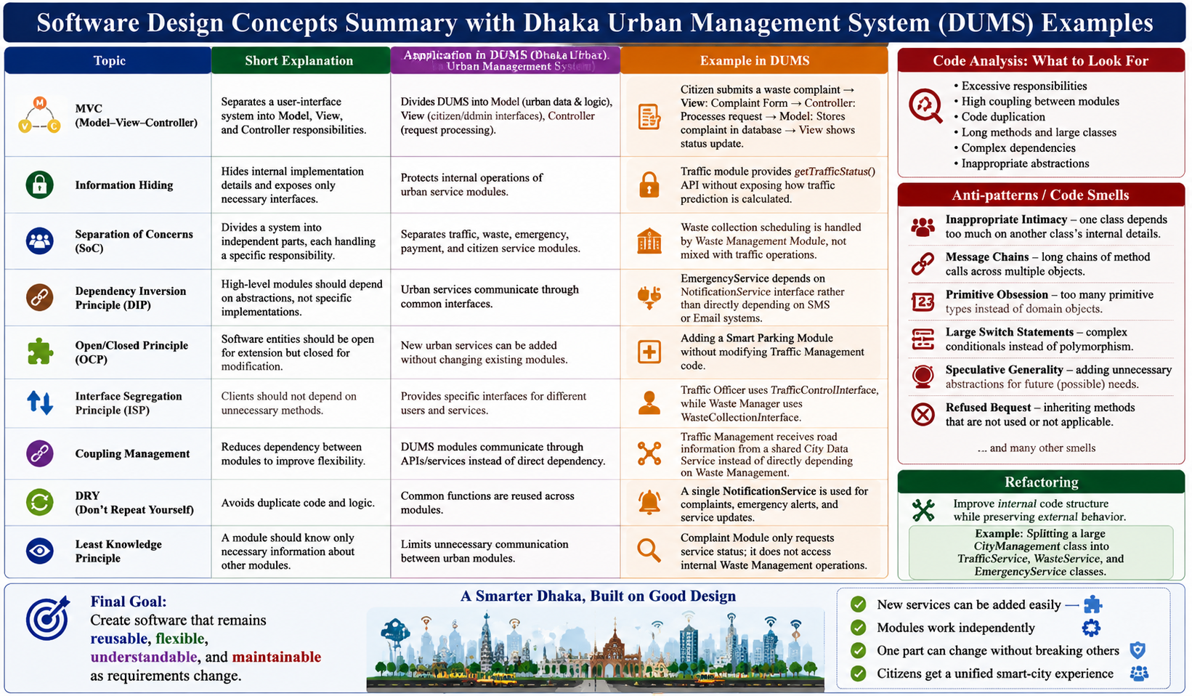
Module 3 — Summary
20

Slide 39
Concept | Short Explanation | Application in Dhaka Urban Management System (DUMS) | Example
MVC (Model–View–Controller) | Separates user interface, data, and request handling responsibilities. | Divides DUMS into Model (urban data & logic), View (citizen/admin interfaces), Controller (request processing). | Citizen submits a waste complaint → View: Complaint Form → Controller: Processes request → Model: Stores complaint in database → View shows status update.
Information Hiding | Hides internal implementation details and exposes only necessary interfaces. | Protects internal operations of urban service modules. | Traffic module provides getTrafficStatus() API without exposing how traffic prediction is calculated.
Separation of Concerns (SoC) | Divides a system into independent parts, each handling a specific responsibility. | Separates traffic, waste, emergency, payment, and citizen service modules. | Waste collection scheduling is handled by Waste Management Module, not mixed with traffic operations.
Dependency Inversion Principle (DIP) | High-level modules should depend on abstractions, not specific implementations. | Urban services communicate through common interfaces. | EmergencyService depends on NotificationService interface rather than directly depending on SMS or Email systems.
Open/Closed Principle (OCP) | Software entities should be open for extension but closed for modification. | New urban services can be added without changing existing modules. | Adding a Smart Parking Module without modifying Traffic Management code.
Interface Segregation Principle (ISP) | Clients should not depend on unnecessary methods. | Provides specific interfaces for different users and services. | Traffic Officer uses TrafficControlInterface, while Waste Manager uses WasteCollectionInterface.
Coupling Management | Reduces dependency between modules to improve flexibility. | DUMS modules communicate through APIs/services instead of direct dependency. | Traffic Management receives road information from a shared City Data Service instead of directly depending on Waste Management.
DRY (Don't Repeat Yourself) | Avoids duplicate code and logic. | Common functions are reused across modules. | A single NotificationService is used for complaints, emergency alerts, and service updates.
Least Knowledge Principle | A module should know only necessary information about other modules. | Limits unnecessary communication between urban modules. | Complaint Module only requests service status; it does not access internal Waste Management operations.
Code Analysis | Evaluates code quality by identifying design problems. | Reviews DUMS modules for maintainability and complexity. | Detecting that Citizen Service class contains login, payment, complaint, and notification responsibilities.
Anti-patterns / Code Smells | Poor design practices that make software difficult to maintain. | Identifies problematic structures before they affect system quality. | A single CityManagement class controlling traffic, waste, emergency, and payment creates excessive responsibility.
Inappropriate Intimacy | One class depends too much on another class’s internal details. | Prevents modules from accessing unnecessary internal data. | Traffic module directly modifying Waste Vehicle database records.
Message Chains | Long sequences of object calls indicate poor design. | Avoids complicated communication paths. | Citizen → Complaint → Department → Manager → Employee → Database (too many dependencies).
Primitive Obsession | Overuse of basic data types instead of meaningful objects. | Encourages proper domain modeling. | Instead of storing location as "23.8103,90.4125" string, create a Location class.
Large Switch Statements | Excessive conditional logic often indicates missing abstraction. | Replaces complex decision structures with polymorphism. | Instead of checking if(service=="Traffic"), if(service=="Waste"), create separate service classes.
Speculative Generality | Adding unnecessary features for possible future use. | Keeps DUMS simple and focused. | Avoid creating unused AI modules before actual requirements exist.
Refactoring | Improving internal code structure without changing external behavior. | Improves maintainability of DUMS while keeping services working. | Splitting a large CityManagement class into TrafficService, WasteService, and EmergencyService classes.
Final Goal | Build software that is reusable, flexible, understandable, and maintainable. | Ensures DUMS can evolve with future smart-city requirements. | Adding new IoT sensors or AI analytics without redesigning the entire system.
20

Slide 40
Sample Question
Explain the responsibilities of the Model, View, and Controller in the MVC Pattern.
What are the three components of the MVC Pattern?
Apply MVC to a university student registration system. Identify suitable responsibilities for the Model, View, and Controller
Design the architecture of an MVC-based Student Management System. Identify the major classes and explain how the Model, View, and Controller communicate.
Explain the DRY principle and the Principle of Least Knowledge.
Bloom's Level | Question
Remember | 1. What are the three components of the MVC Pattern?
Understand | 2. Explain the responsibilities of the Model, View, and Controller in the MVC Pattern.
Understand | 3. Explain how the MVC Pattern supports separation of concerns.
Apply | 4. Apply MVC to a university student registration system. Identify suitable responsibilities for the Model, View, and Controller.
Analyze | 5. Analyze a program in which the Controller performs input validation, database operations, business logic, and HTML generation. Identify the design problems.
Evaluate | 6. Evaluate the benefits of separating database operations, business logic, request handling, and presentation in an MVC-based application.
Create | 7. Design the architecture of an MVC-based Student Management System. Identify the major classes and explain how the Model, View, and Controller communicate.
Bloom's Level | Question
Remember | 1. Define an anti-pattern and a code smell. Give three examples of code smells.
Understand | 2. Explain the meaning of the Large Class, Long Method, and Duplicated Code smells.
Understand | 3. Explain the concepts of Primitive Obsession and Message Chains.
Apply | 4. A method contains 100 lines of code and performs validation, database access, calculations, and report generation. Identify the likely code smell and suggest an appropriate refactoring approach.
Analyze | 5. Analyze a system where the same switch statement for customer types appears in five different methods. Identify the code smell and explain why it creates maintenance problems.
Evaluate | 6. Evaluate whether every occurrence of a code smell must always be refactored. Explain why the context of the software design should be considered.
Create | 7. Create a refactored design for a system suffering from a Large Class and Duplicated Code. Identify how responsibilities should be redistributed among multiple classes.
Bloom's Level | Question
Remember | 1. What are the DRY principle, Principle of Least Knowledge, Open/Closed Principle, and Information Hiding?
Understand | 2. Explain how the DRY principle improves software maintainability.
Understand | 3. Explain why excessive coupling between classes can make software difficult to maintain and modify.
Apply | 4. Consider a class that directly accesses several internal objects of another class through a long chain of method calls. Identify the relevant design principle and suggest how it could be improved.
Analyze | 5. Analyze the following situation: a superclass provides five methods, but a subclass only needs one of them and ignores the other four. Identify the possible code smell and explain the design problem.
Evaluate | 6. Evaluate the following statement: “Using more design patterns always results in better software design.” Support your answer with appropriate examples from Modules 1–3.
Create | 7. Create a design-improvement plan for a poorly designed Java application containing a Large Class, Duplicated Code, Primitive Obsession, long methods, and tightly coupled classes. Explain which design principles, patterns, and refactoring techniques you would use.
20

Slide 41
Sample Question
A method contains 100 lines of code and performs validation, database access, calculations, and report generation. Identify the likely code smell and suggest an appropriate refactoring approach.
Analyze a system where the same switch statement for customer types appears in five different methods. Identify the code smell and explain why it creates maintenance problems.
Analyze a method containing 150 lines that performs validation, database operations, calculations, and report generation. Identify the possible smells and explain how they affect maintainability.
Evaluate whether comments are always beneficial in software development. Explain how excessive comments may sometimes indicate a design problem.
Create a refactoring plan for a Java application suffering from a Large Class, Long Methods, and Duplicated Code. Explain the sequence of improvements you would make.
Bloom's Level | Question
Remember | 1. What are the three components of MVC? State the primary responsibility of each component.
Understand | 2. Explain how separation of concerns is achieved through the MVC Pattern.
Understand | 3. Explain the DRY principle and the Principle of Least Knowledge.
Apply | 4. A Student Management System contains database queries directly inside its GUI classes. Apply the principles of MVC and separation of concerns to improve the design.
Analyze | 5. Analyze a class that performs database access, user-interface formatting, validation, and business calculations. Identify the possible design problems and code smells.
Evaluate | 6. Evaluate the statement: “A large class is always an example of bad design.” Discuss the importance of context when identifying code smells.
Create | 7. Design an MVC architecture for an online course-registration system. Identify the Model, View, Controller, and major responsibilities of each.
Bloom's Level | Question
Remember | 1. Define Large Class, Long Method, Duplicated Code, and Primitive Obsession.
Understand | 2. Explain why duplicated code can make software difficult to maintain.
Understand | 3. Explain the difference between Divergent Change and Shotgun Surgery.
Apply | 4. A program contains the same student-validation code in five different classes. Identify the code smell and propose an appropriate refactoring approach.
Analyze | 5. Analyze a method containing 150 lines that performs validation, database operations, calculations, and report generation. Identify the possible smells and explain how they affect maintainability.
Evaluate | 6. Evaluate whether comments are always beneficial in software development. Explain how excessive comments may sometimes indicate a design problem.
Create | 7. Create a refactoring plan for a Java application suffering from a Large Class, Long Methods, and Duplicated Code. Explain the sequence of improvements you would make.
Bloom's Level | Question
Remember | 1. Define Inappropriate Intimacy, Message Chains, Primitive Obsession, Speculative Generality, and Refused Request.
Understand | 2. Explain why the Principle of Least Knowledge is useful for reducing unnecessary dependencies.
Understand | 3. Explain why speculative generality can lead to unnecessary complexity in a software system.
Apply | 4. A class accesses several objects through a long chain such as student.getDepartment().getTeacher().getOffice().getPhone(). Identify the possible design issue and suggest an improvement.
Analyze | 5. Analyze a superclass that contains several methods that are not required by one of its subclasses. Identify the likely code smell and explain why it may indicate an inappropriate inheritance relationship.
Evaluate | 6. Evaluate the statement: “Design patterns should always be used to improve software design.” Discuss situations in which applying a design pattern could actually make a simple system unnecessarily complicated.
Create | 7. Create a complete design-improvement strategy for a poorly designed Java application containing tight coupling, duplicated code, primitive obsession, long methods, and inappropriate intimacy. Identify the design principles, patterns, and refactoring techniques you would apply.
20

